Slide 1
UNIT 8 Microsoft Windows Security Configuration

Slide 2
Learning Objectives
Learn how to implement proper file-level permissions on Windows systems
Purpose, use, and types
Permission inheritance and parent/child relationships
Customization
Understand how backups function and best-practice backup strategies
Availability and integrity
Major backup techniques and types
Configuration
Understand how audit logging and system monitoring are performed and configured
Audit logging purpose and configuration
Performance monitoring purpose and configuration
www.uscyberpatriot.org
2
© Air Force Association’s CyberPatriot Program

Slide 3
UNIT 8 – SECTION 1 Windows File Protections

Slide 4

The CIA Triad (Review)
3 Goals of information security:
Maintain information confidentiality
Making sure only approved users have
access to data
Maintain information
integrity
Data Integrity: assurance that information has not been tampered with or corrupted between the source and the end user
Source Integrity: assurance that the sender of the information is who it is supposed to be
Maintain information availability
Ensuring data is accessible by approved users when needed
Source: http://www.techrepublic.com/blog/it-security/the-cia-triad/

Slide 5
File Permissions
Important tool for ensuring data integrity and confidentiality
More customizable than the blanket set of permissions given to users by adding them to either the Users or Administrators group
Use to restrict access or editing rights to specific data on shared resources
Can be customized by individual user or by user group

Slide 6
File Permissions
Restrict access or editing rights to data on shared resources
Types of permissions:
Full Control
Modify
Read & Execute
List Folder Contents
Write
Read

Slide 7

Types of File Permissions
Full Control
Administrator level access
Users can make every possible change to a selected file or the contents of a selected folder
Modify
Allows users to change a file’s content, but not its ownership
Users cannot delete the file
Read & Execute
Allows users to open and run programs
List Folder Contents
Allows users to view the names of files stored in the selected folder
Write
Allows users to make changes to a file and overwrite existing content
Read
Allows users to view the attributes of a file or folder, but not edit it

Slide 8
Inheritable Permissions
By default, objects within a folder (known as child objects) inherit permission settings from their containing folder (known as the parent object)
You can turn off inheritable permissions and customize who gets
what kind of access to certain folders, subfolders, or documents
Depending on how many users need access to a sensitive file or folder and how many of the files in a folder need to be restricted, there are several ways to apply permissions
Example: If you want certain users or groups to be denied access to all but a few files within a folder, it is quickest to apply a restrictive permission setting to the parent object (folder). Once you have denied those users’ access to all of the files in the folder, you can go to the individual files you do want them to have access to and override the permissions those files inherited from the parent folder.

Slide 9
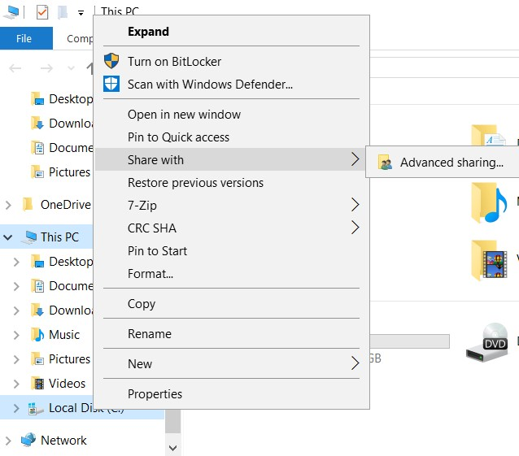
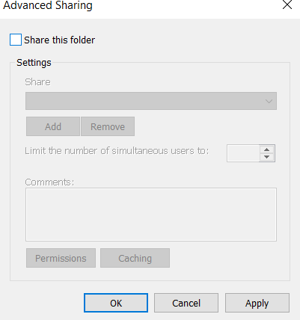
Sharing Drives
You can share an entire network’s files by sharing its drives
Generally not a good idea – Anyone could see or modify your files
To turn off Sharing Drives: Open File Explorer→ Click This PC→ Right Click the Local Disk Drive → Share with → Advanced Sharing → Uncheck Share this folder → Click OK

Slide 10
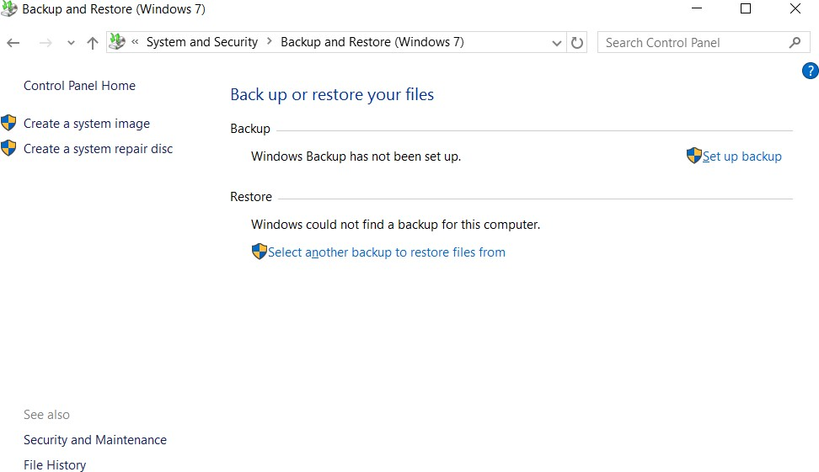
Creating Backups
Control Panel 🡪 System and Security 🡪 Backup and restore
System image: Contains files, programs, system files, and settings
Create a System repair disc: Contains necessary system files

Slide 11
UNIT 8 – SECTION 2 Windows Auditing and Monitoring

Slide 12
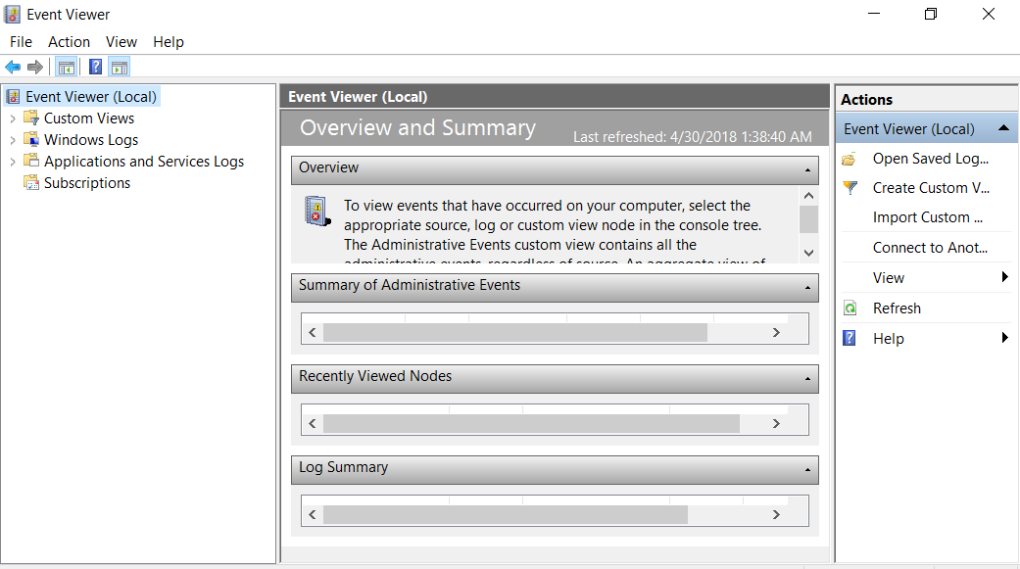
Event Viewer
Displays logs of events occurring on the Windows operating system
Control Panel → System and Security → Administrative Tools → Event Viewer
OR Search → Event Viewer
www.uscyberpatriot.org

Slide 13
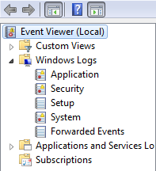
Windows Logs
Security logs can be a useful last defense against attacks and a tool for forensics investigations into the source of a past attack or unauthorized entry
Customize what security logs are kept by setting Audit Policies
Events logged by programs
Any successful or unsuccessful logon attempts Events that occurred during installation
Events logged by system components
Events forwarded from other computers

Slide 14
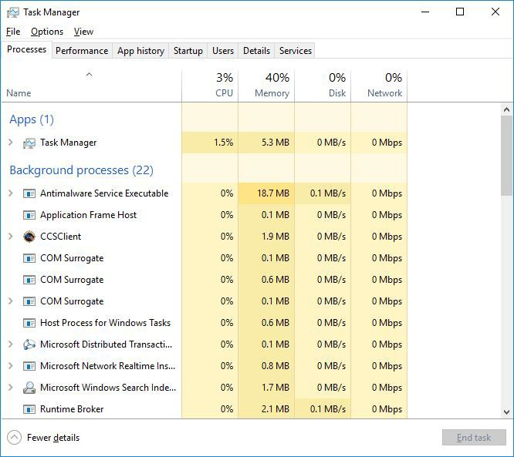
Task Manager
Shows programs, services, and processes currently running
Shows network activity and resource utilization
Search → Task Manager
Note: If the Task Manager is showing few details, then
click “More details” here

Slide 15
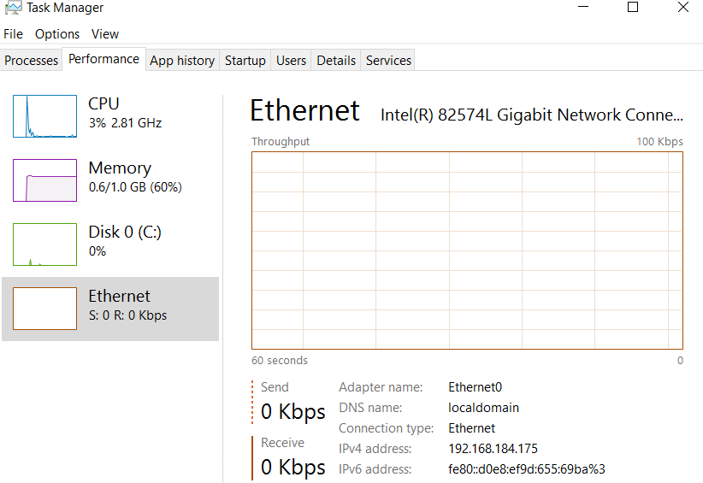
Task Manager: Performance
CPU: Monitors current and past resource use
CPU usage by core
Multi-core Processors

Slide 16
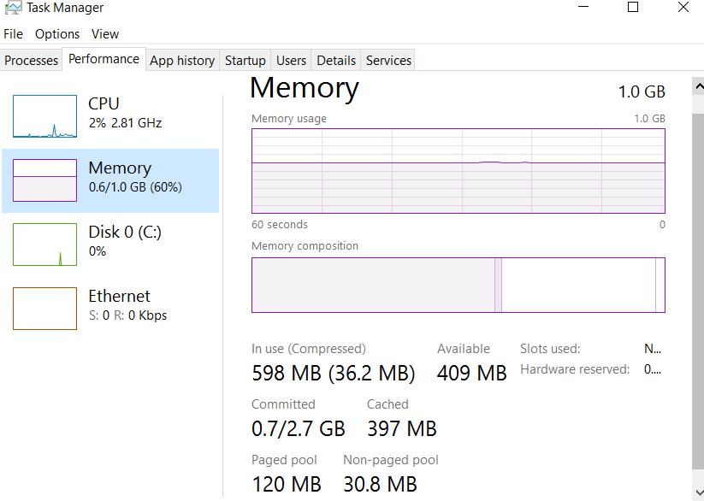
Task Manager: Performance (cont.)
Memory Usage

Slide 17
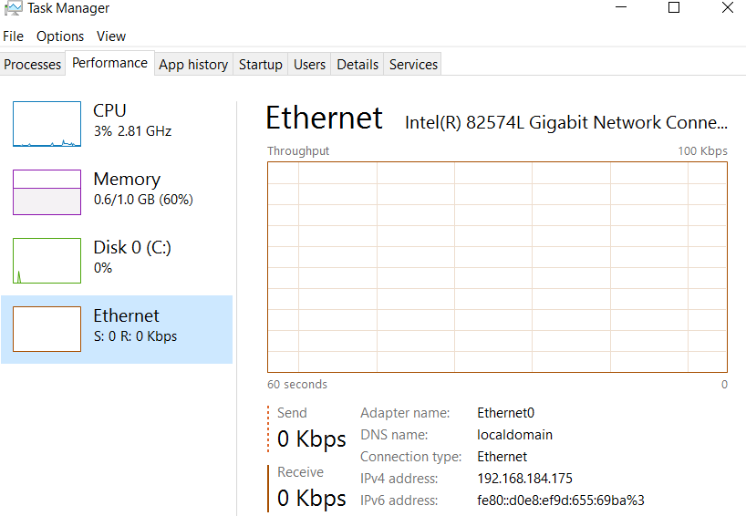
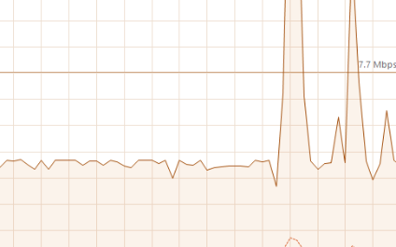
Task Manager: Ethernet
Graph of network usage

Slide 18
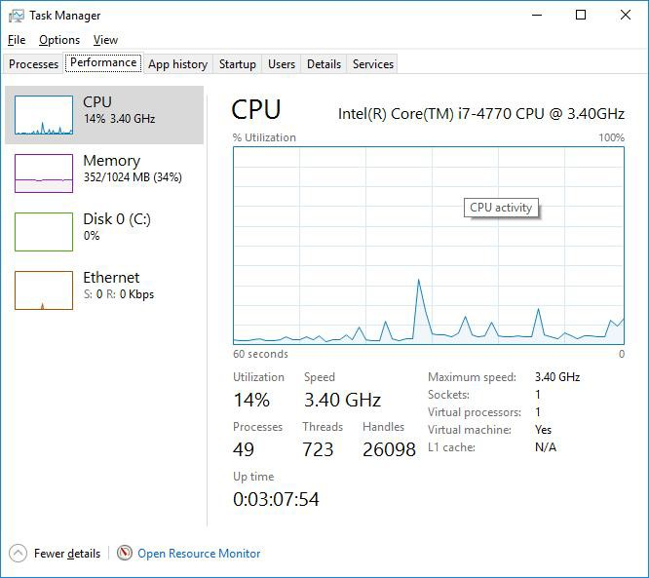
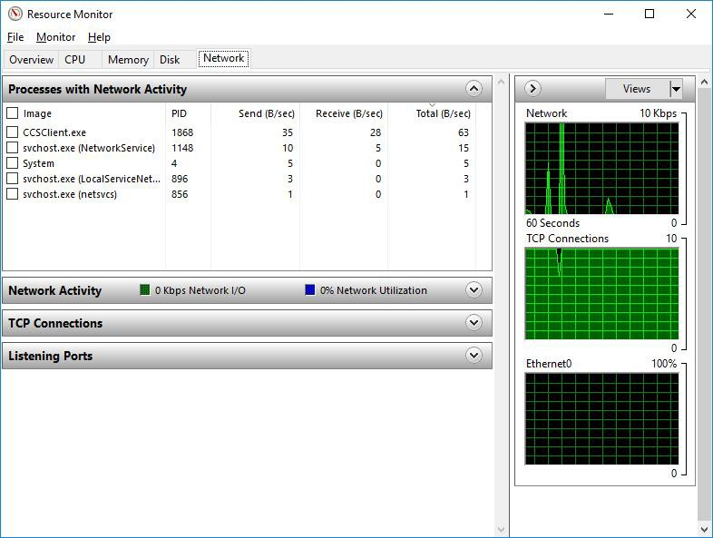
Task Manager: Performance Tab
Performance problems can arise from a broken router, switch, or cable, or from the
computer itself
To see resource utilization details: Click Open Resource Monitor
Source: http://www.bleepingcomputer.com/tutorials/how-to-use-the-windows-task-manager/#networking

